Slide 1
Introduction to Programming
Lecture 3

Slide 2
Agenda
Revise one dimensional Array
Two-dimensional Arrays (2D arrays)

Slide 3
One dimensional Arrays Revision

Slide 4
Arrays
An Array is used to store multiple values in a single variable, instead of declaring separate variables for each value.
An Array is a collection of items of the same data type.
How to declare an array of strings?
string names [400];
string cars[5];
You reserved 5 places in the memory, each one of them could store a string

Slide 5
Declaring and Initializing an array
To declare an array, define the variable type, specify the name of the array followed by square brackets , and specify the number of elements it should store.
string cars[5];
Initializing your array:
You could initialize your array with values once you create it, and you could change the value later if you want.
string cars[5] = {"Volvo", "BMW", "Ford", "Mazda", “Toyota" };
Volvo | BMW | Ford | Mazda | Toyota

Slide 6
Accessing an Array element
How to access an element from the array?
string cars[5] = {"Volvo", "BMW", "Ford", "Mazda", “Toyota" };
Each element has an Index.
0 | 1 | 2 | 3 | 4
Volvo | BMW | Ford | Mazda | Toyota
The first element is at index 0.
The last element is at index size of the array-1.

Slide 7

Accessing an Array element
Array Indexes
0 | 1 | 2 | 3 | 4
Volvo | BMW | Ford | Mazda | Toyota
Array Elements
cout<<cars[0];
Volvo
How to modify an element of an array?
cars[0] = "Nissan";
cout<<cars[0];
Nissan
0 | 1 | 2 | 3 | 4
Nissan | BMW | Ford | Mazda | Toyota

Slide 8


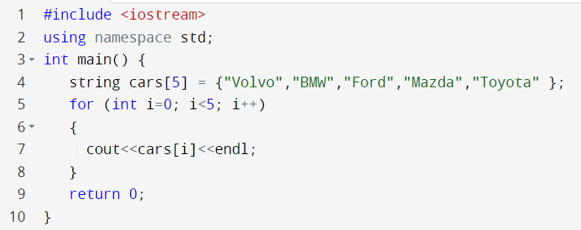
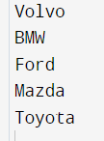


Printing an Array
Do I have to cout each element in an array in a separate statement?
Just use a for loop to pass by the indexes
The last index must be array size -1
0 | 1 | 2 | 3 | 4
Volvo | BMW | Ford | Mazda | Toyota

Slide 9
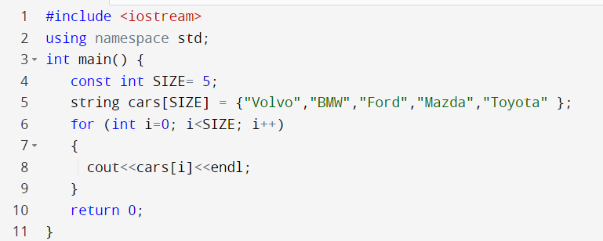
Good Programmer Tip

Slide 10
Two-dimensional Arrays

Slide 11
Two-dimensional Arrays
2D Arrays are defined as an array of arrays
It can also represent a matrix.
10 | 20 | 30 | 40 | 50
60 | 70 | 80 | 90 | 100
Each element is represented by two indexes
→ An index representing its row position
→ An index representing its column position

Slide 12
Two-dimensional Arraya
10 | 20 | 30 | 40 | 50
60 | 70 | 80 | 90 | 100
col 0
col 4
row 0
a[0][0] | a[0][1] | a[0][2] | a[0][3] | a[0][4]
a[1][0] | a[1][1] | a[1][2] | a[1][3] | a[1][4]
row 1
Each element is represented by two indexes
→ An index representing its row position
→ An index representing its column position

Slide 13
Declaring a two dimensional Array
int arr[2][5];
The above statement declares a 2D array where the number of rows is 2 and the number of columns is 5.
col 0
col 4
row 0
10
50
row 1
80
arr[0][0] = 10;
arr[0][4] = 50;
arr[1][2] = 80;

Slide 14
Initializing a two-dimensional Array
int arr[2][5]= { {10,20,30,40,50},
{60,70,80,90,100}};
10 | 20 | 30 | 40 | 50
60 | 70 | 80 | 90 | 100
You could initialize it like this too, and the array elements will be filled row by row:
int arr[2][5]= { 10,20,30,40,50, 60,70,80,90,100};

Slide 15
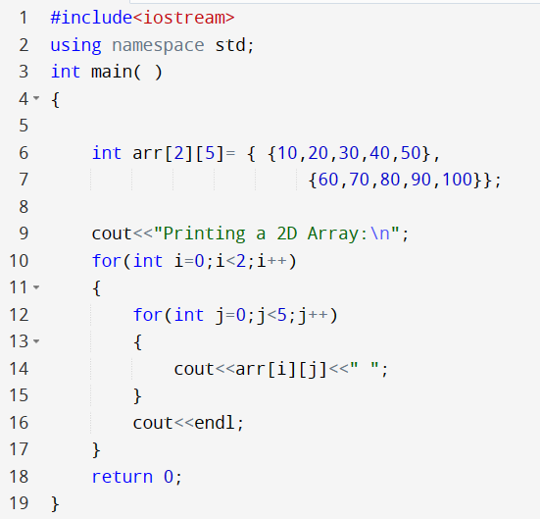

Printing a two-dimensional Array
10 | 20 | 30 | 40 | 50
60 | 70 | 80 | 90 | 100
Outer loop passing by rows
inner loop passing by columns within each row

Slide 16
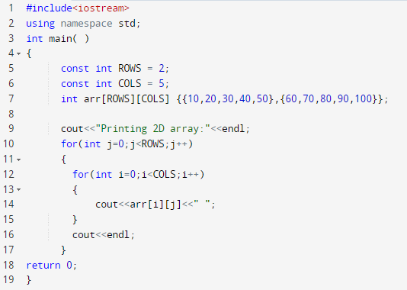

Printing a two-dimensional Array
10 | 20 | 30 | 40 | 50
60 | 70 | 80 | 90 | 100

Slide 17

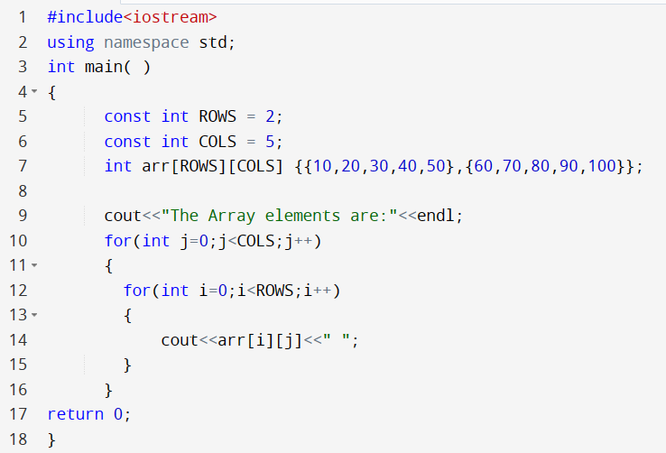

Printing a two-dimensional Array
I want to pass by columns first??
Outer loop passing by Cols
10 | 20 | 30 | 40 | 50
60 | 70 | 80 | 90 | 100
inner loop passing by rows within each column

Slide 18
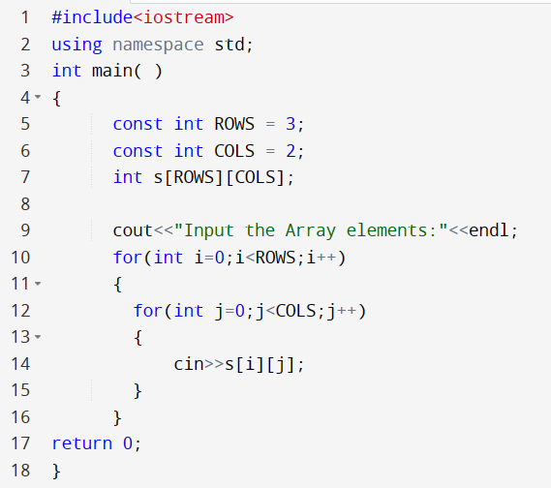
Reading the Array Elements
3 rows and 2 columns

Slide 19

Examples

Slide 20
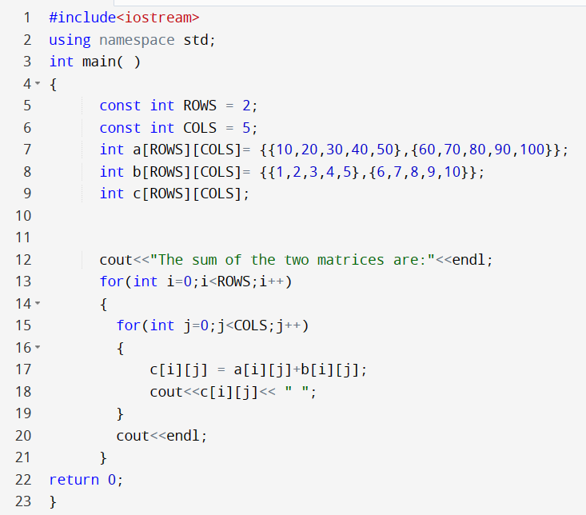

Example 1: Sum of two matrices
10 | 20 | 30 | 40 | 50
60 | 70 | 80 | 90 | 100
a
b
1 | 2 | 3 | 4 | 5
6 | 7 | 8 | 9 | 10
Expected output matrix
c
11 | 22 | 33 | 44 | 55
66 | 77 | 88 | 99 | 110

Slide 21

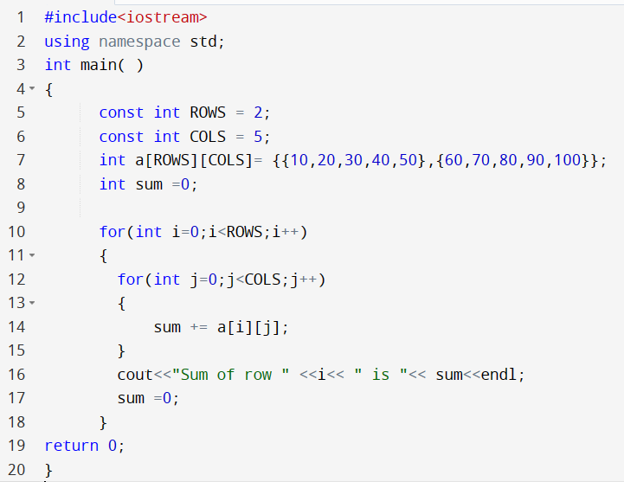


Example 2: Sum of all rows
Write a program to print out the sum of all elements in each row of a 2D array.
a
10 | 20 | 30 | 40 | 50
60 | 70 | 80 | 90 | 100

Slide 22
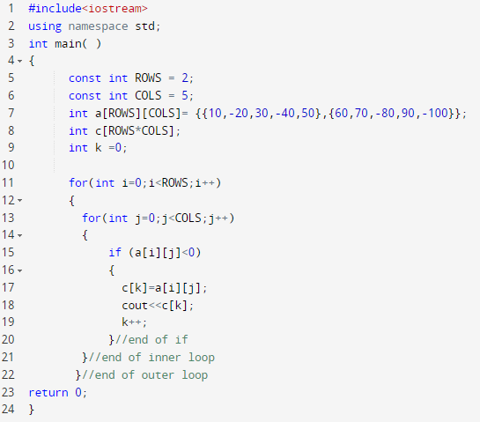

Example 3: Extract negative numbers
j
i
10 | -20 | 30 | -40 | 50
60 | 70 | -80 | 90 | -100
a
Expected output array
c
-20 | -40 | -80 | -100
k
What is the size of array c?
We need a separate variable as an index to pass by c.

Slide 23

Swapping
Remember swapping code
Input →
A = 30
B=50
First step →
Temp = A //Temp now is 30
Second step →
A =B //Both A and B is 50
Third step →
B = Temp //B now is 30
output →
A = 50
B= 30
int A = 30;
int B = 50;
int Temp;
Temp = A;
A=B;
B=Temp;

Slide 24
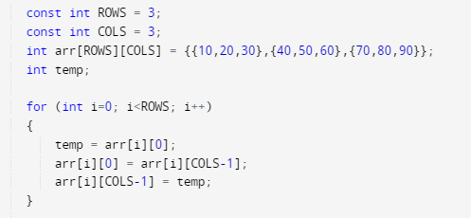
Example 4: Swap first and last columns
10 | 20 | 30
40 | 50 | 60
70 | 80 | 90
Expected output array
30 | 20 | 10
60 | 50 | 40
90 | 80 | 70

Slide 25
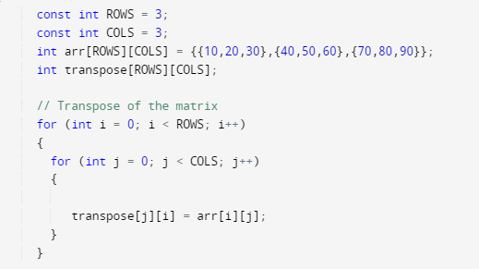
Example 5: Transpose of a matrix
j
Assume the matrix has an equal number of rows and columns. Write a program to transpose the matrix.
i
10 | 20 | 30
40 | 50 | 60
70 | 80 | 90
arr
Expected output array
transpose
10 | 40 | 70
20 | 50 | 80
30 | 60 | 90
a[2][1] should be go where?
80
transpose[1][2]

Slide 26

Example 6: let’s create a Math game
Assume a 2D array where the number of rows is 3, and the number of columns is exactly 5
30 | + | 40 | =
10 | * | 2 | =
12 | / | 3 | =
arr
To convert from string to int
string x = “30”;
int y = stoi(x);
Expected output array
30 | + | 40 | = | 70
10 | * | 2 | = | 20
12 | / | 3 | = | 4
arr
To get the first character of a string:
string x = “+”;
char y = x.at(0);
To convert from int to string:
int x = 30;
string y = to_string(x);
#include <string> should be added in your code

Slide 27
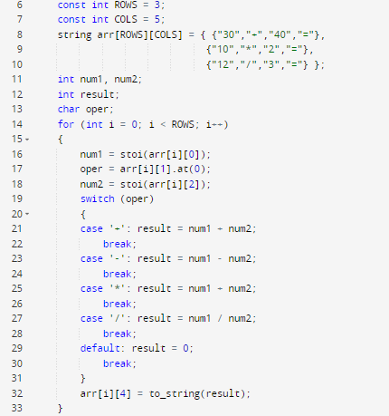
Example 5: let’s create a Math game
30 | + | 40 | =
10 | * | 2 | =
12 | / | 3 | =
arr
Expected output array
30 | + | 40 | = | 70
10 | * | 2 | = | 20
12 | / | 3 | = | 4
arr

Slide 28

Thank You

